Slide 1
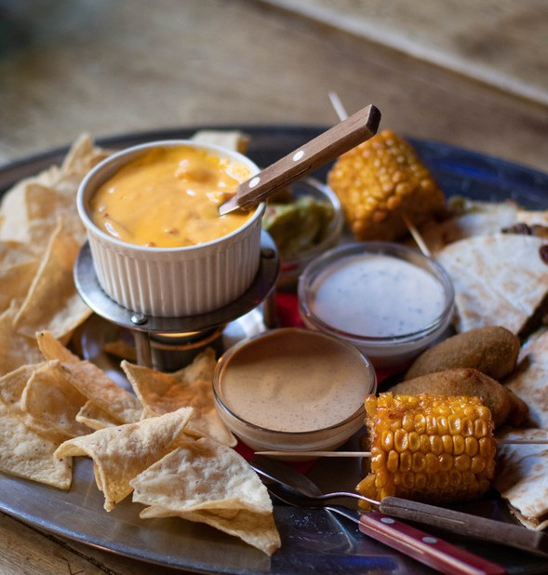
The Recipe Book.
A website with all the recipes of the authentic dishes of India and famous Italian and american dishes.

Slide 2
"Laughter is brightest where food is best."
- Irish proverb
Project Made By-
Soumya Darbha
Maha Lakshmi Annavarapu

Slide 3
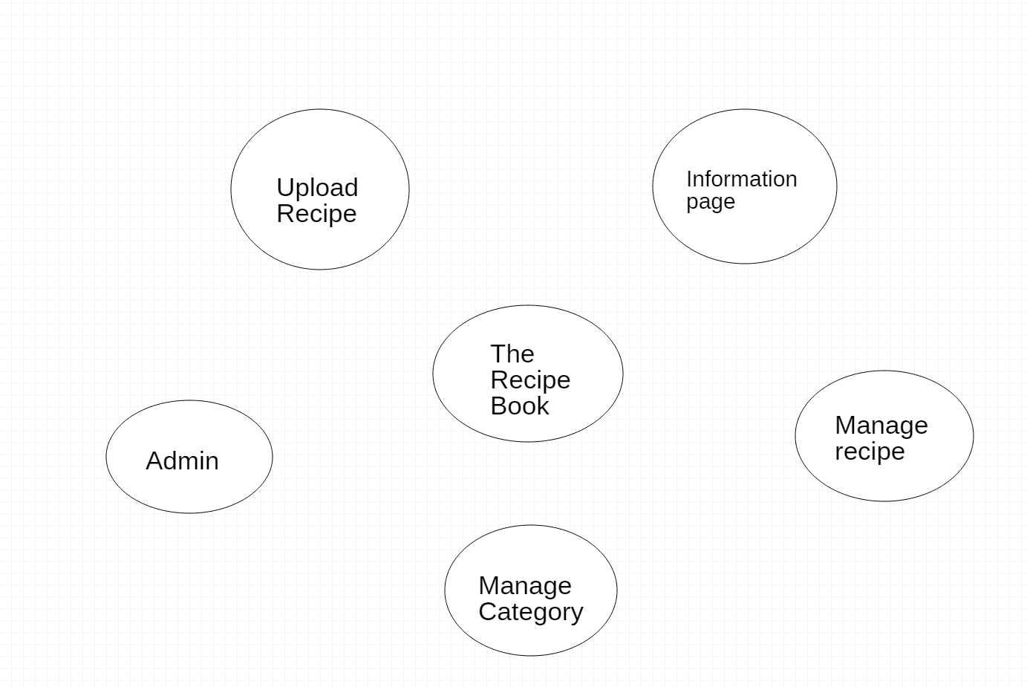
Uy
UML Diagram

Slide 4
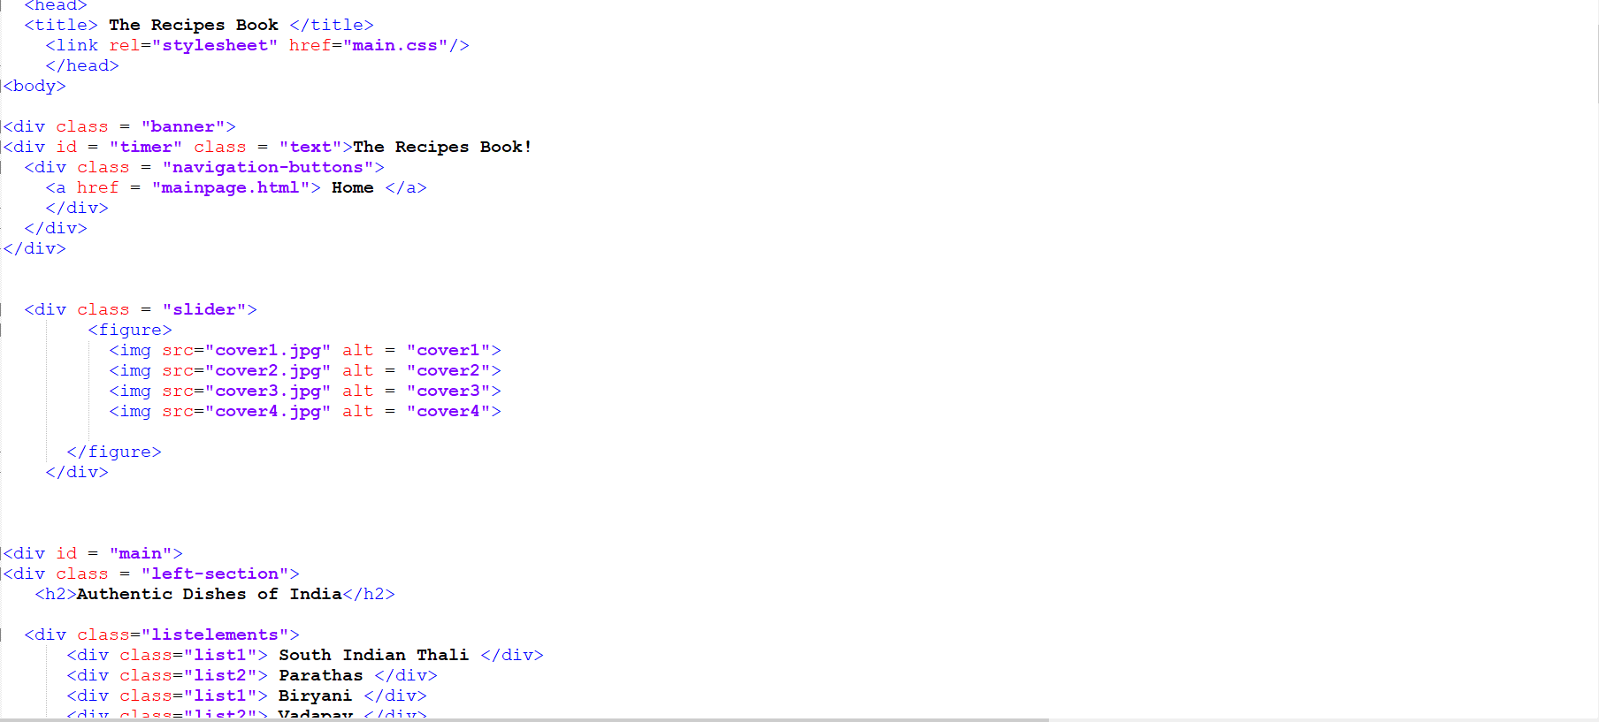
MAIN PAGE:
HTMLCODE

Slide 5
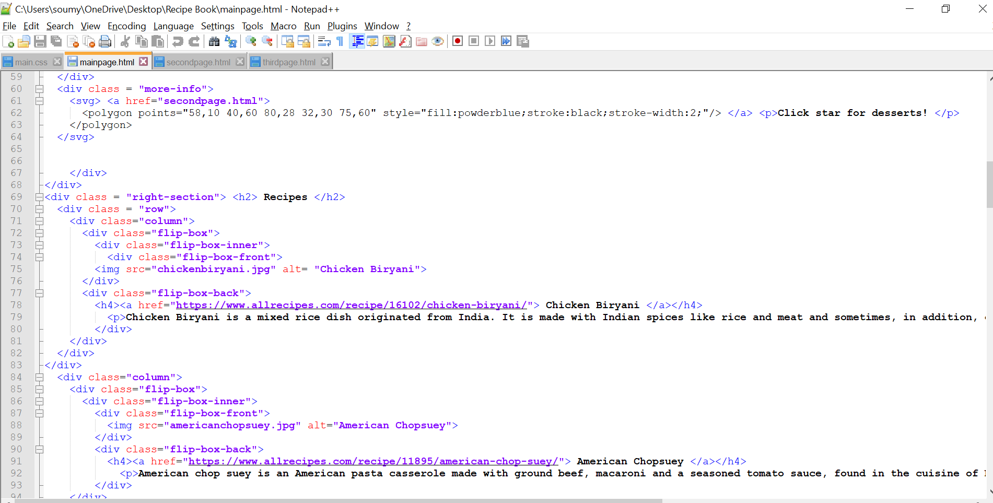

Slide 6
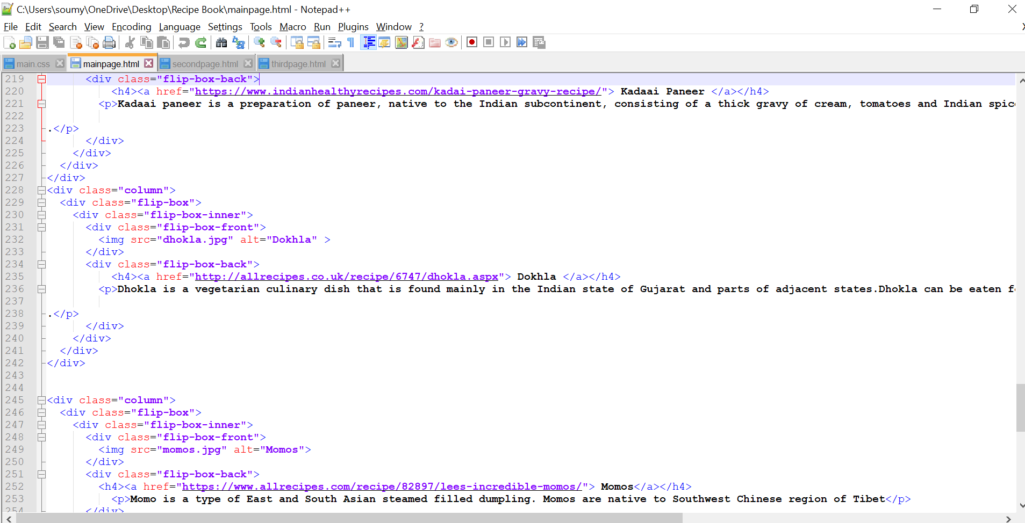

Slide 7
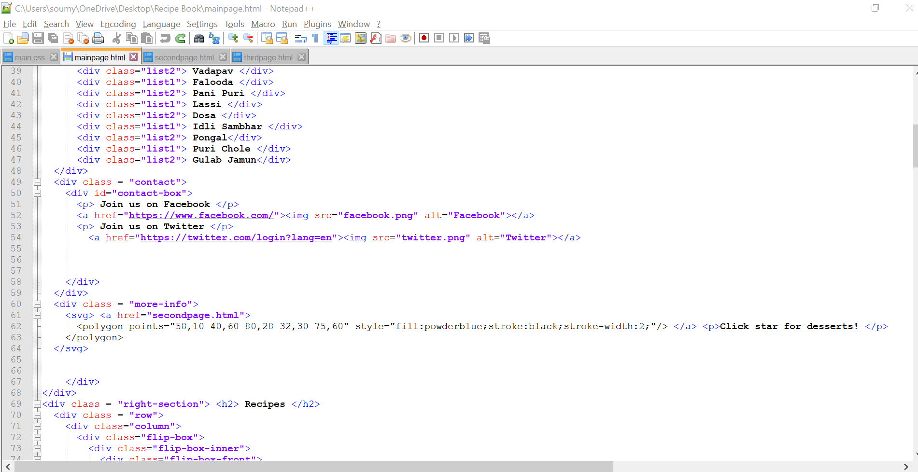

Slide 8
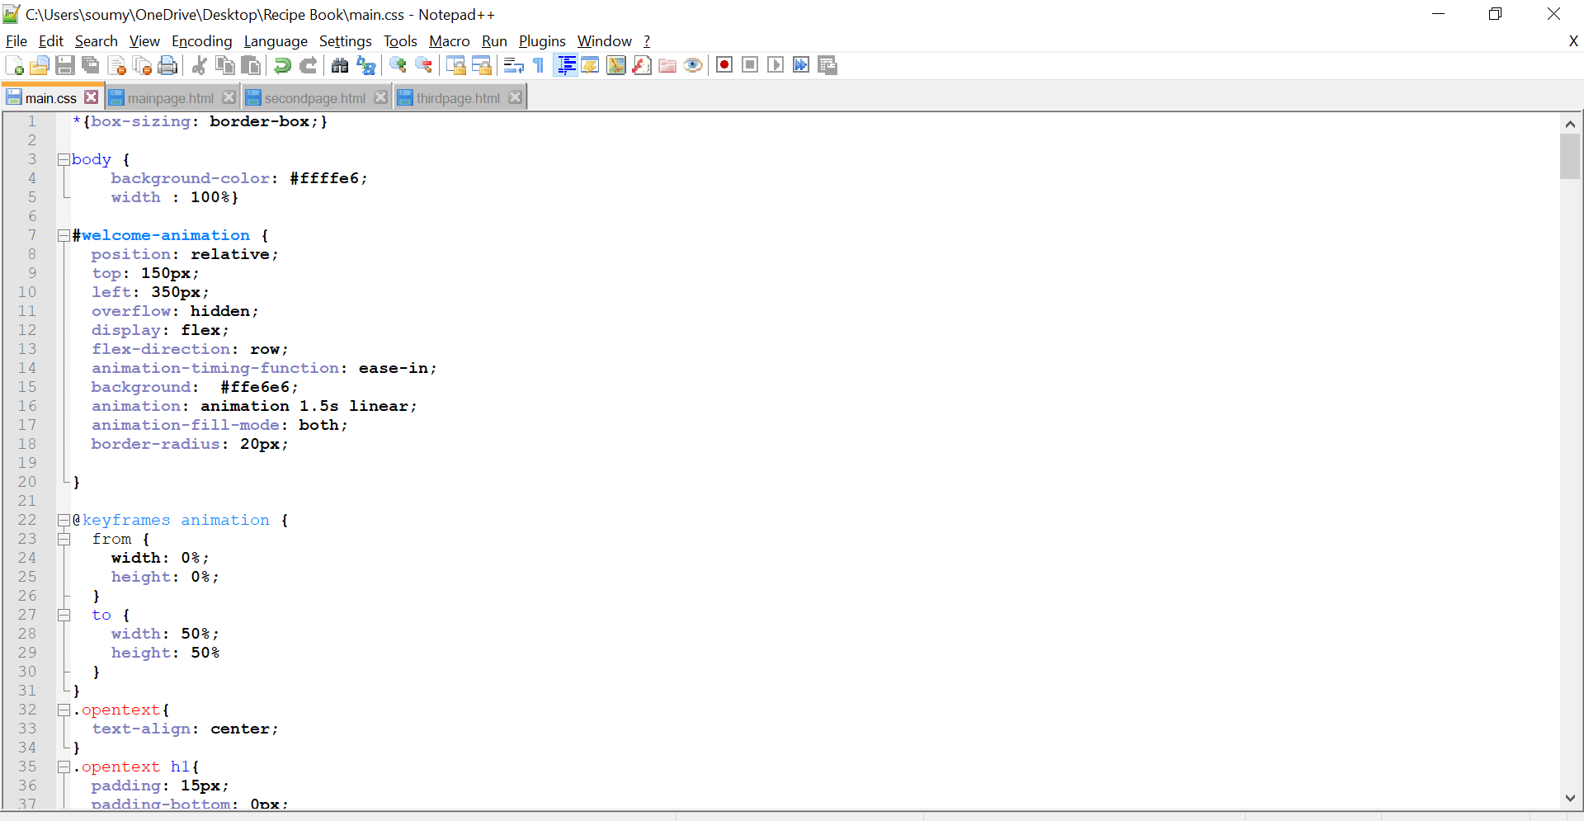
MAIN PAGE:
CSS CODE

Slide 9
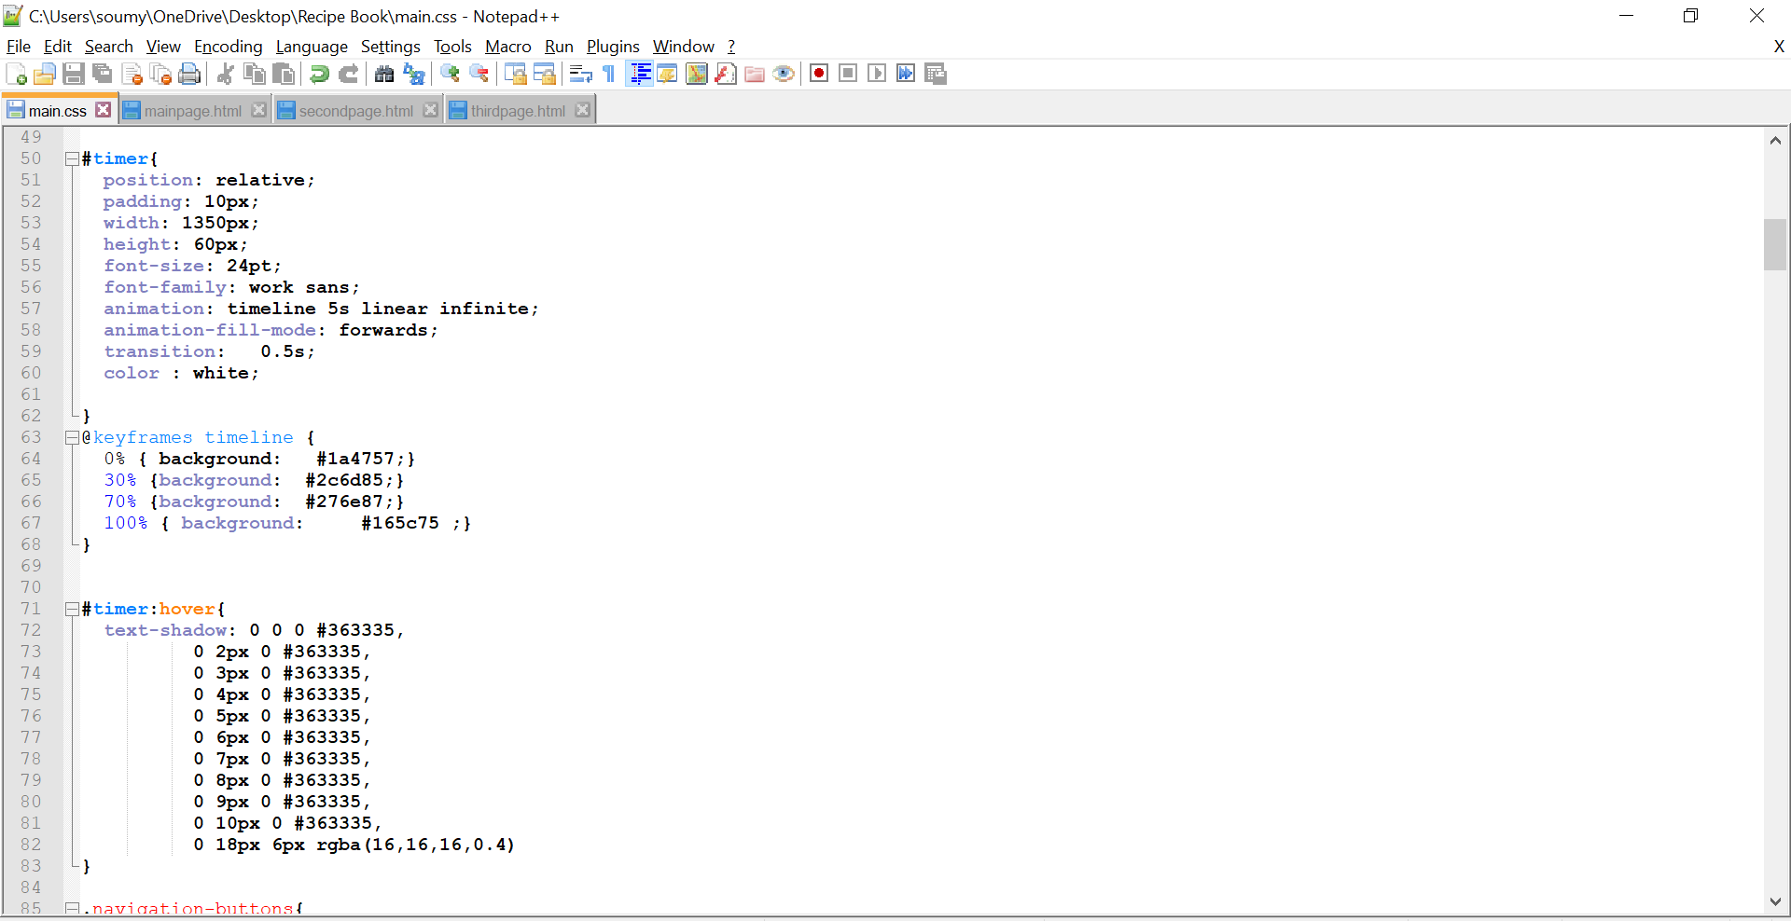

Slide 10
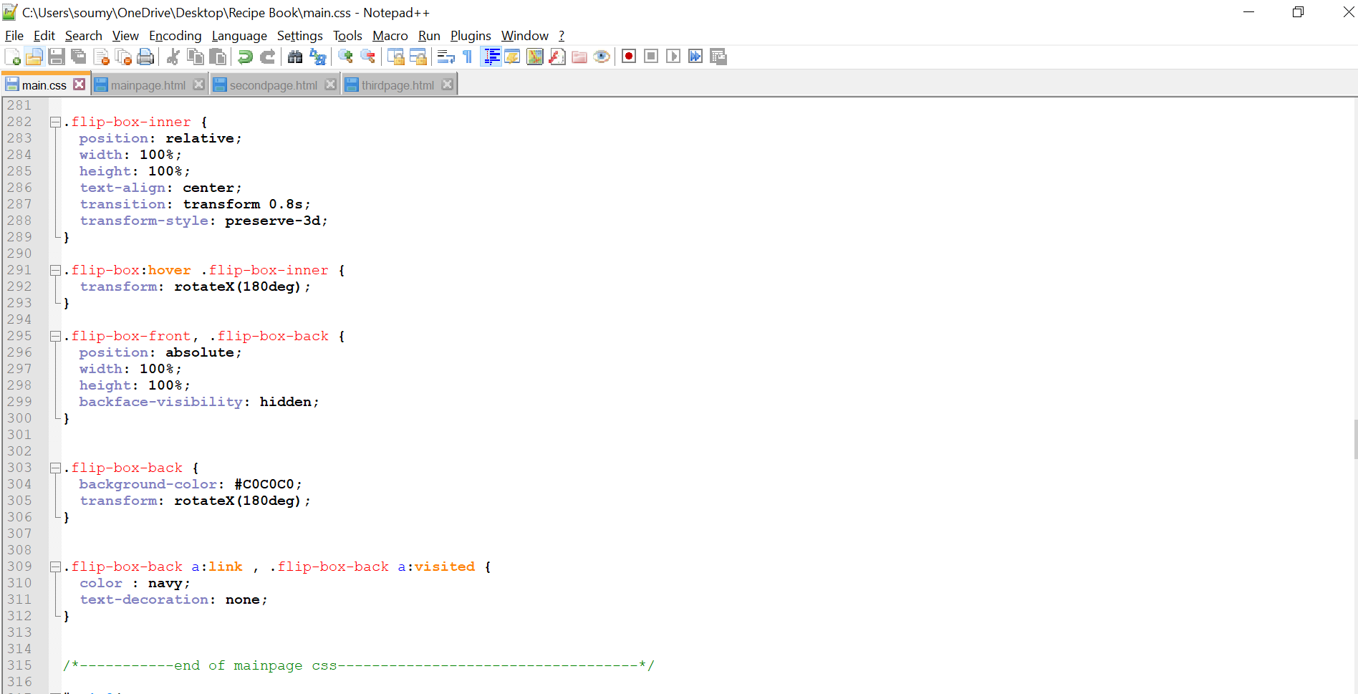

Slide 11
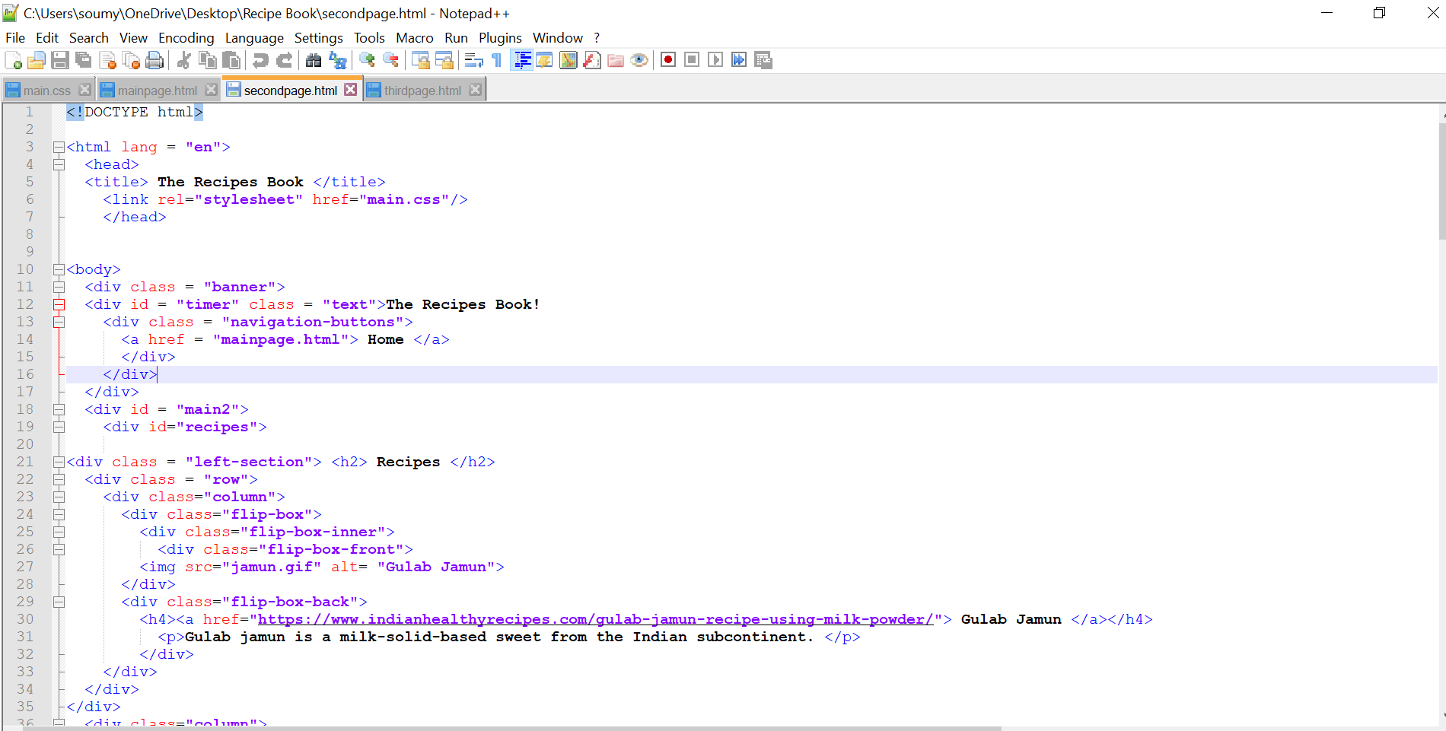
SECOND PAGE
HTMLCODE

Slide 12
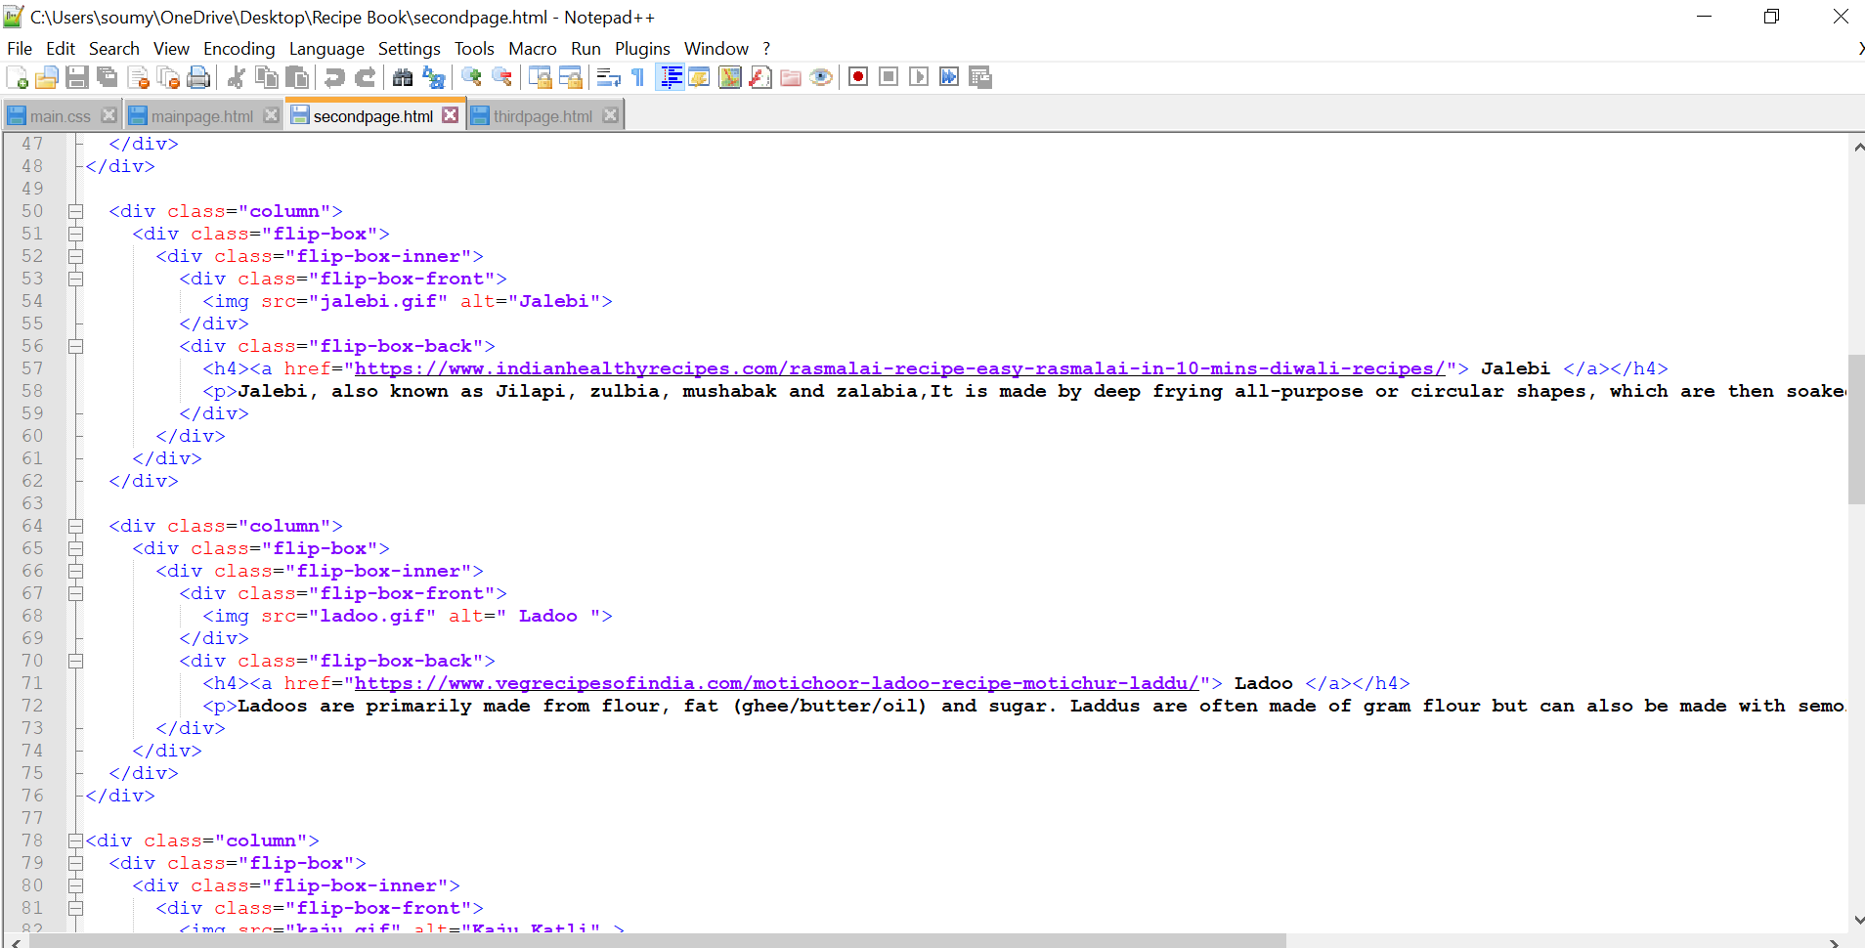

Slide 13
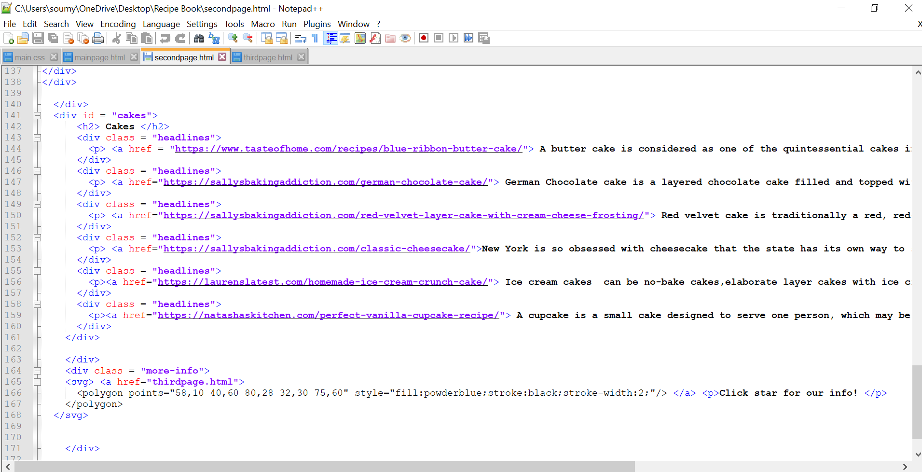

Slide 14
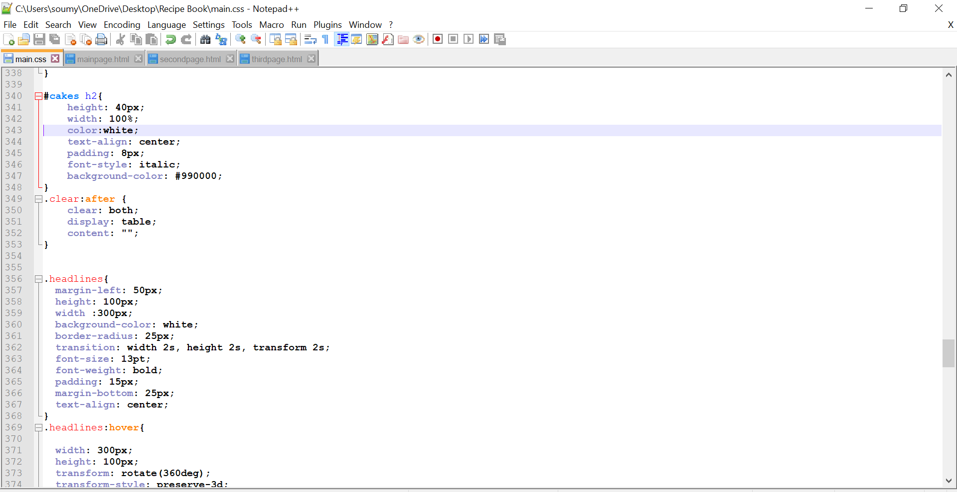
SECOND PAGE:
CSS CODE

Slide 15
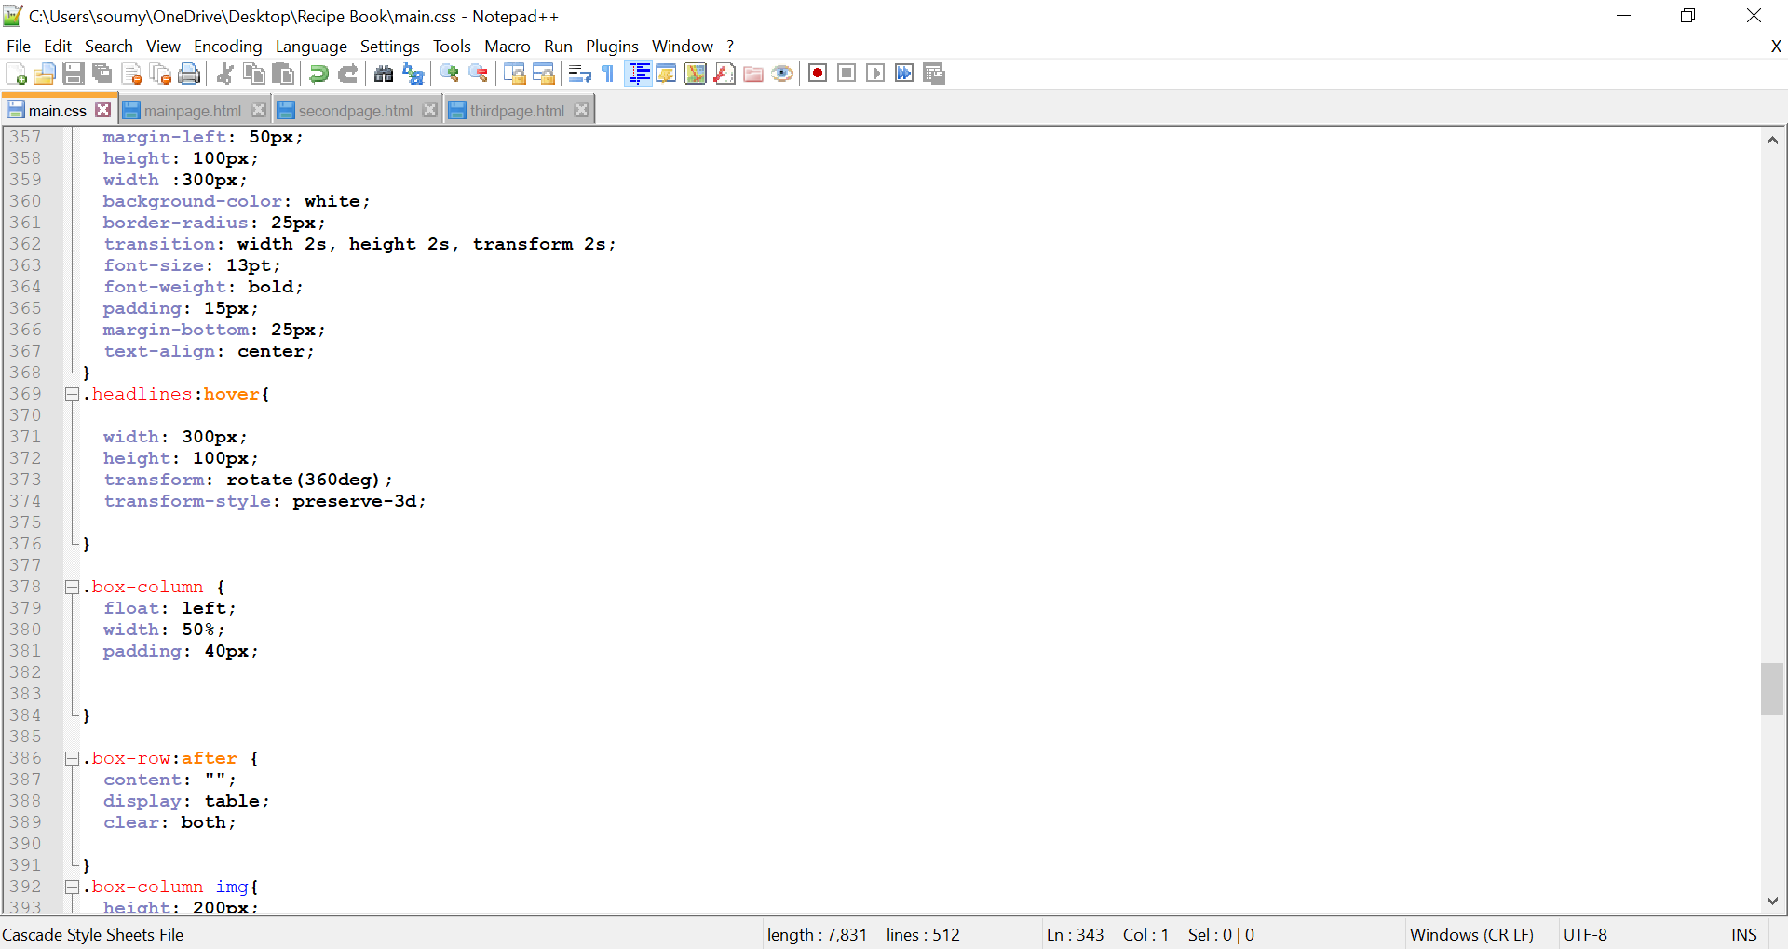

Slide 16
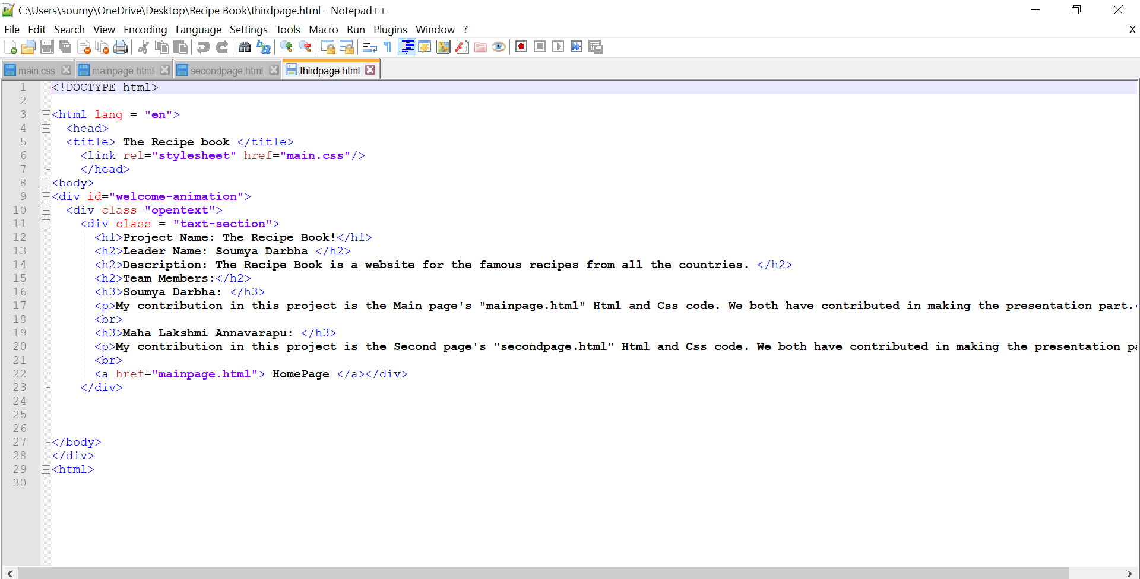
THIRD PAGE
HTML CODE

Slide 17
THANK YOU

